Slide 1


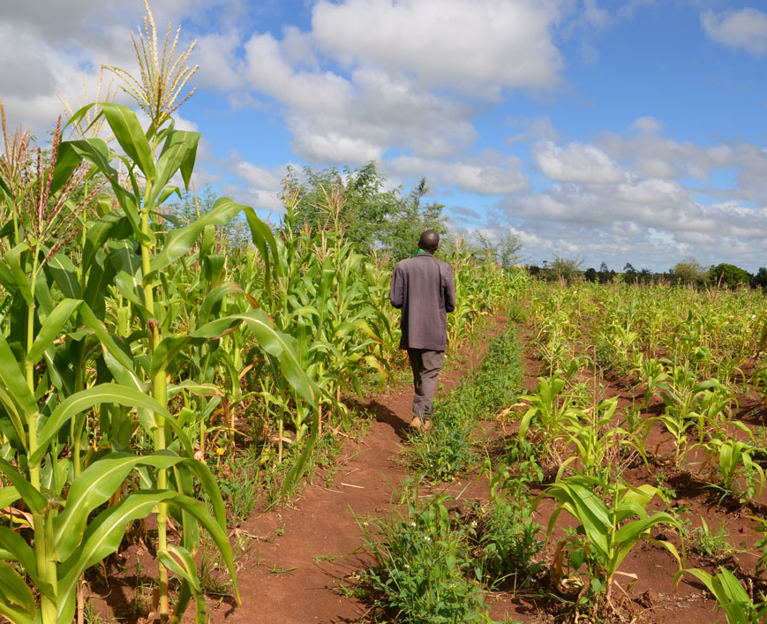

TAMSAT-ALERT for Impact-Based Forecasting
Session 2: Methodology Part 1
Notes:
Welcome to the next session in our course on TAMSAT-ALERT for Impact-Based Forecasting. This session focuses on methodology. In Part 1, we will be looking at how we estimate soil moisture and the water resource satisfaction index, which is also known as WRSI.

Slide 2
Learning objectives
Explain TAMSAT-ALERT soil moisture and WRSI as a drought impact-relevant metric
Understand modelling of soil moisture and WRSI
Understanding TAMSAT-ALERT approach to forecasting
Ability to interpret TAMSAT-ALERT soil moisture and WRSI forecasts
Ability to produce TAMSAT-ALERT forecast plots and/or bulletins
Notes:
You will remember that we set out several learning objectives for the course as a whole. This session will help you understand how we model soil moisture and WRSI.

Slide 3
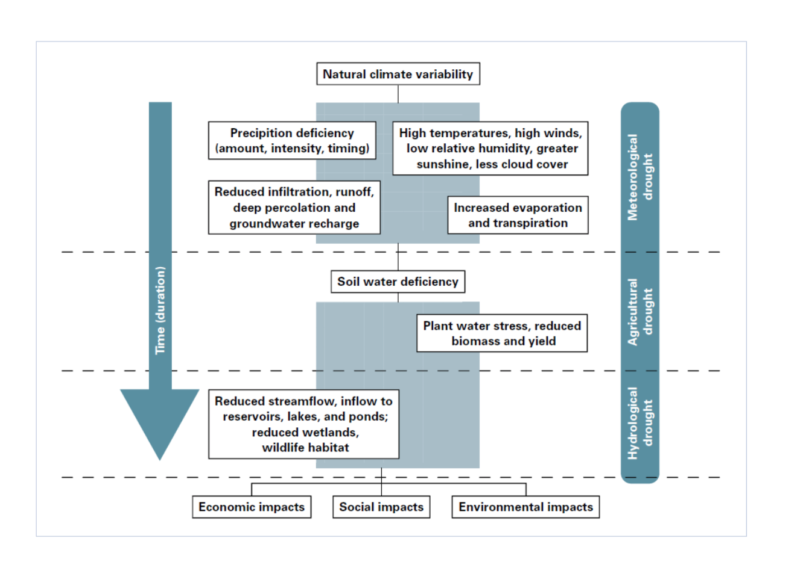
Soil moisture, plant water stress and drought
Source: National Drought Mitiga- tion Center, University of NebraskaLincoln, USA, https://drought.unl.edu/Education/ DroughtIn-depth/TypesofDrought.aspx
Notes:
During a season, droughts may progress from meteorological drought, which develops as a result of deficit in rainfall or excess evaporation to agricultural and hydrological drought. Agricultural drought is plant water stress, resulting from a deficit in soil moisture in the root zone leads. Plant water stress will tend to reduce crop yields, with severe socio-economic impact on communities that depend on rainfed agriculture.
Agricultural drought is strongly related to meteorological drought but meteorological drought does not necessarily lead to agricultural drought. For example, agricultural drought is more likely to develop if the soil is very dry at the beginning of the growing season, so a great deal of rainfall is needed to provide adequate water for plant growth. Also, the likelihood of agricultural drought depends to some extent on the texture of the soil (how coarse it is and the organic content).
Variability in climate and soil type means that some regions are more vulnerable to agricultural drought than others.
The figure in the slide is a schematic showing the progression from meteorological drought to hydrological drought over time. It illustrates that natural climate variability leads to high temperatures and low rainfall, and then to reduced infiltration, runoff and percolation in the soil. High temperatures also cause increased evaporation. These factors lead to soil moisture deficit and to plant water stress. Plant water stress, in turn, causes reduced biomass and yield. In addition, the reduced run off and soil moisture, as well as the enhanced evaporation cause reduced streamflow, inflow to reservoirs, and also detrimental impacts on wetlands. The hydrological and agricultural drought have direct environmental impacts, social impacts and national scale economic impacts.

Slide 4
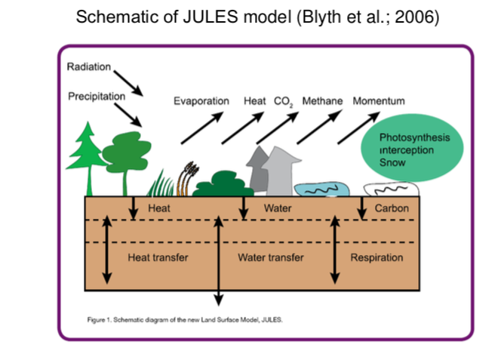
Calculation of soil moisture
Model inputs and outputs
Meteorological inputs:
Precipitation
2m air temperature (mean, max, min)
2m humidity
10m wind speed
Surface pressure
In JULES: long and shortwave radiation fluxes
In our model: Skin temperature
Other inputs:
Soil texture
Vegetation properties:
Rooting depth
Canopy height
Leaf area index
Additional crop parameters:
Development stage growing degree days
Vegetation properties for development stages
Planting date
Kc (for modification of potential evapotranspiration)
Notes:
Our soil moisture model is based on the JULES (joint UK land environment simulator) land-surface model. JULES is also the land surface component of the UK met office climate model and so it has been applied globally and extensively tested and evaluated. The reading list at the end provides full details about JULES.
The key points here are that our model simulates all the key terrestrial elements of the water cycle including evaporation, infiltration, percolation and run off. The model is driven with observed meteorological data, and can be applied anywhere in the world. It accounts for variation in temperature and humidity, as well as in precipitation.
Additionally, the model accounts for the effect of soil texture and vegetation on soil moisture content.
Overall, the model provides a more comprehensive representation of terrestrial processes than models like Aquacrop.
A caveat with the application of our model over Africa, is that it is difficult to observe soil moisture directly. Other methods of validation were covered in the previous session.
The figure on the slide is a schematic of the JULES land surface model. JULES takes in prescribed fluxes of radiation and precipitation, as well as other inputs listed in full in the grey box. Depending on the vegetation and soil cover, water coming into the model is partitioned into evaporation, runoff and infiltration. JULES also includes a photosynthesis scheme, which determines plant transpiration. Our model is a simplified version of JULES.

Slide 5
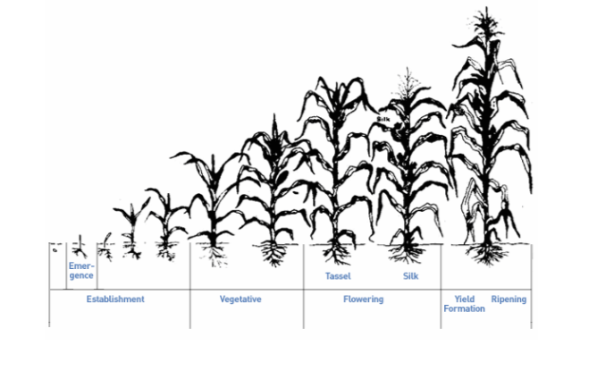
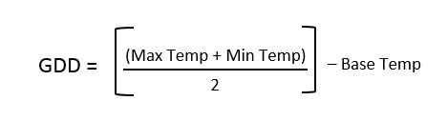
Calculation of WRSI
Each development stage takes a characteristic time, measured in growing degree days (GDD). This is illustrated for an example crop below:
Seasonal WRSI is equivalent to the mean soil moisture deficit in the root zone, calculated over the growing season (McNally et al, 2015 DOI: 10.1175/JHM-D-14-0049.1)
How to calculate WRSI
1. Derive the crop development stage (which is determined by temperature i.e. growing degree days)
2. Calculate the rooting depth, for the crop development stage
3. Use the soil moisture model described in the previous slide to calculate the soil moisture deficit in the root zone for a given day
4. Derive the harvest date (based on growing degree days), and hence the growing season
5. Cumulate the daily root zone soil moisture deficit over the entire growing season.
50-100 GDD
600-900 GDD
600-1000 GDD
200-300 GDD
Notes:
The effect of drought on plants depends on the extent to which their roots can access the water they require to grow and develop. This is encapsulated by the Water Resource Satisfaction Index, which represents the soil moisture deficit in the root zone, cumulated over the growing season. The model described in the previous slides can be adapted to calculate WRSI.
The first stage is to adapt the soil moisture model to grow crops. With crops, the vegetation parameters (leaf area index, canopy height and rooting depth) vary according to the stage of growth. So a seedling has very shallow roots, whilst a mature plant has deep roots.
A common approach used by the FAO is to determine the crop development stage using growing degree days – see formula on the slide. For each day, the GDD is calculated as described above. The cumulative GDD can be used to determine the stage of the growing season. So for the example above, after 50-100 GDD, the plant emerges, after a further 600-900 GDD the plant reaches its flowering stage, and so on. The harvest date, and hence the growing season length is thus automatically calculated, depending on the required number of growing degree days and the daily temperature. In our model, the planting date is prescribed by the user. The number of growing degree days required for each development stage depends on the crop and the variety. Again, these quantities are prescribed by the user.
The second stage of our calculation of WRSI is to run the model with the varying rooting depth, canopy height and leaf area index derived in the first part of the process. The model calculates soil moisture deficit in the rooting zone and outputs it at a daily time step.
The final stage is to calculate the mean WRSI over the growing season. The dates of the growing season will vary spatially, depending on regional variations in temperature and planting date. In general, a WRSI of less than 50% is considered indicative of significant water stress on plants – in other words agricultural drought. By this definition, large parts of Africa experience agricultural drought in a high proportion of years.

Slide 6
Examples of WRSI predictions
Notes:
To lead us into the next session, here are examples of some WRSI predictions made using the TAMSAT-ALERT system for the 2019-2020 southern Africa growing season. The plot on the left shows the predicted WRSI, and the plot on the right compares this prediction to the usual conditions (climatology). It can be seen that in the southern part of the region, WRSI is predicted to be low, while in the northern and eastern part of the region, we are not expecting severe agricultural drought. Conditions are near normal.
In the next session we will look at how the TAMSAT-ALERT system can be used to predict soil moisture and WRSI.

Slide 7
Next steps
Do the multiple-choice quiz to cement your understanding
Explore the additional reading and other resources listed in the ‘Additional resources’ document
Ask the TAMSAT team any questions you have [e.c.l.black@reading.ac.uk]
When you are ready, move on to the next session, which is about soil moisture and WRSI forecasting

